Slide 1
Wild Vacations Website
Bishan Meghani

Slide 2
Wild Vacations
Online holiday booking website
A wide range of destinations at great prices
Staff at Wild Vacations work continuously to find their customers great deals
Comprehensive and fast bookings

Slide 3
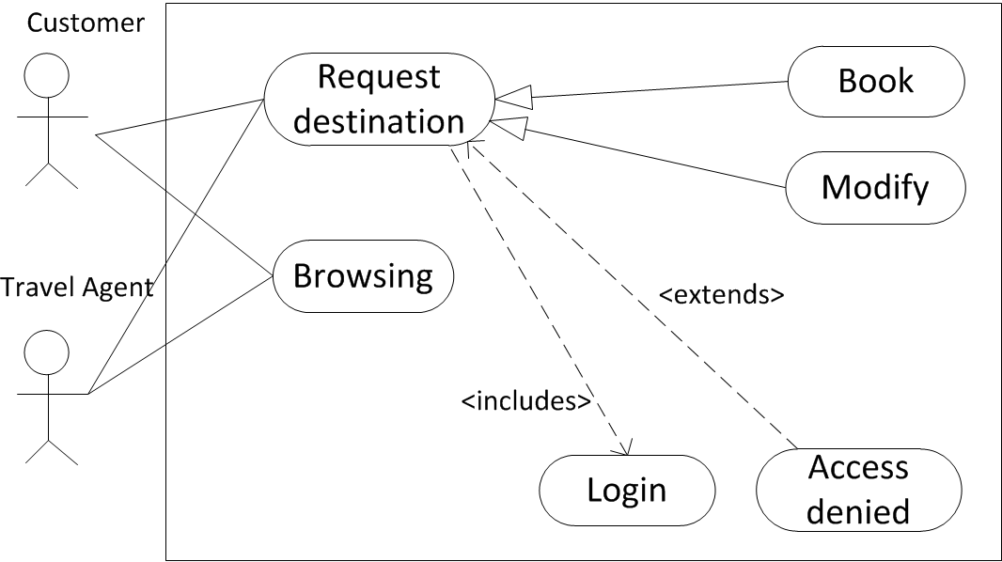
UML User Case

Slide 4
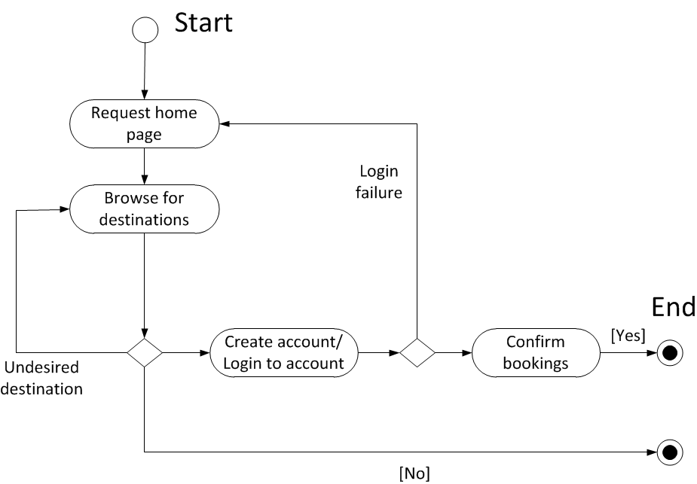
UML Activity Diagram

